Slide 1
2016 Year 11 learning conference
The on-Line Learning environment
Mrs Donovan M.Ed. - Leadership/ Information Management

Slide 2

Information in the 21st century
An information landscape characterised by:
  Technological change (new formats, delivery modes)
  Differentiation (layered landscape)
  Overload
  Complexity
  Density
  De-contextualisation
  Access 24/7
  A.I. enhanced & user friendly
  Faster, smaller, convergent
  > Storage, cloud computing
  Easy manipulation
  Multimedia
  Interactive
Public Domain Web (8-10%
The Web = iceberg
The Internet
The Deep Web
90+%

Slide 3

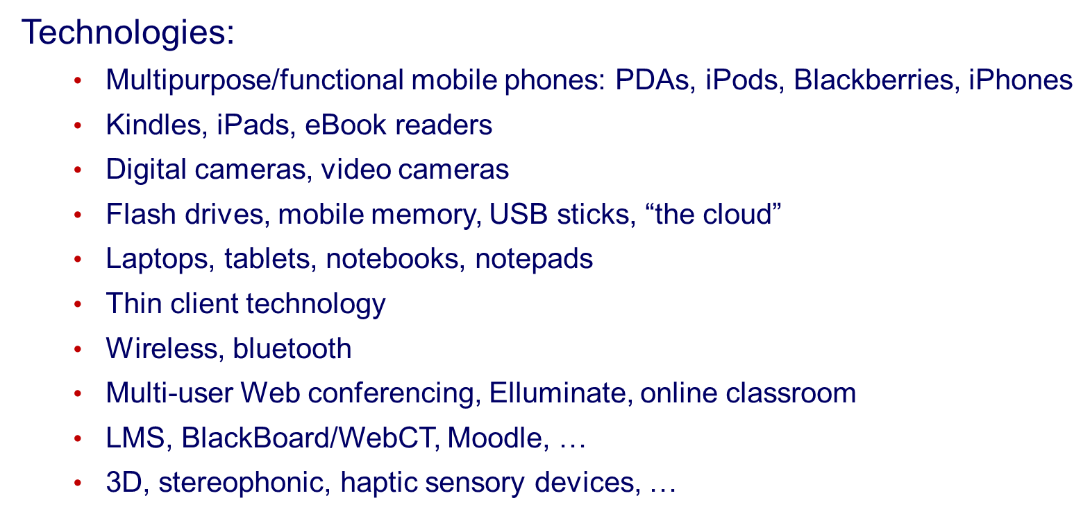

Slide 4

Web 2.0 Utilities
  Interactive
  Social
  Public domain
  One-to-many
  RSS Feeds
  Twitter
  Nings
  Jing
  Wikis
  Blogs
  Voicethread
  Weebly …

Slide 5

And after searching online in many different directions………

Slide 6

You may end up High and Dry feeling like you’re just wasting your time…

Slide 7
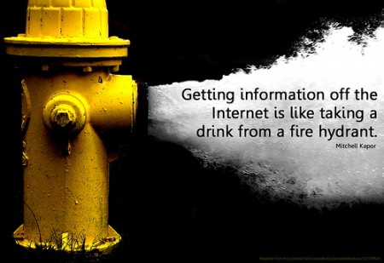

Slide 8

So you need to know how to manage the flow of information…

Slide 9
Evaluate the online tool using the commonly known:
C. R. A. P. method

Slide 10
C.R.A.P.
Currency
Reliability
Authority
Purpose/Point of View

Slide 11
C.
Currency
How recent is the information?
How recently has the website been updated?
Is it current enough for your topic?

Slide 12
R.
Reliability
What kind of information is included in the resource?
Is content of the resource primarily opinion? Is it balanced?
Does the creator provide references or sources for data or quotations?

Slide 13
A.
Authority
Who is the creator or author?
What are the credentials?
Who is the publisher or sponsor?
Are they reputable?
What is the publisher’s interest (if any) in this information?
Are there advertisements on the website?

Slide 14
P.
Purpose/Point of View
Is this fact or opinion?
Is the creator/author trying to sell you something?
Is it biased or political?

Slide 15
Useful Websites for Senior Students:
JHS Library Search Engine: OLIVER Search Library resources from any internet connected device.
JHS Li - BLOG - ary is a digital collection of great websites for Students, Parents and Staff
State Library allows FREE access to data bases valued at $5000 p/a. Visit the website and sign up for free library membership

Slide 16
Advanced Search
Search the word tigers and get about 182,000,000 results.
Add the word animal and get about 20,800,000 results. Use advanced search…. Ad the word endangered then select region and domain (edu and au) as well as file type Power point and you arrow down your search to 56 results!!!
The Search Engine List provides a comprehensive list of useful search engines for a variety of topics.

Slide 17
Delicious.com and DIIGO can save your best websites to the cloud so you can always access them!!
Khan Academy is like having your own private tutor 24/7
The School for Excellence provides great resources and study tips for senior students in Australia.

Slide 18
Online tools for Presenting Assessments/Information
Animoto Create videos from images
Benettonplay Create stunning animations
Classtools.net Create educational games
Gliffy Create floor plans, flowcharts and 3D diagrams
Glogster EDU Create interactive multimedia posters
Kerpoof Create movies and stories
Mixbook Create a page turning e-book
Myebook Create an e-book
PoducateMe Exe files How to create a podcast
Power League Create an online debate
Prezi A zooming presentation tool
Scratch Join up and download programming software to create digital learning objects
Sketchcast Embed evolving sketches into your blog
SketchUp Create, modify and share 3D models
Storybird Collaborative storytelling
Storyjumper Create a page turning e-book
Technology tips and cybersafety
Timetoast Create a free online timeline
Voice Thread Hold an online conversation about an image
Voki Create a personalised speaking avatar
Wordle Create word clouds to summarise main concepts of a unit for students

Slide 19

Education is hard work…..
Band 4, 5 and 6 students value:
Concentration
Perseverance
Deliberate practice
Learning

Slide 20
Work Smarter….
ALARM == Assessment preparation
Cornell == Exam preparation
Seven Strips and PEEL == Summarising techniques
Here Hidden and Head Summarising method
Online Web tools

Slide 21
ALARM = A Learning and Response Model
ALARM is a fancy way of asking yourself …..
“SO WHAT?”

Slide 23
ALARM meets CORNELL
Statement of the Topic: Write an introductory sentence which includes the name, definition, description and general explanation of the key concept or “dot point”. Band 6 level responses in the HSC will relate the topic to the exam question and demonstrate a thesis, opinion or initial judgement of the concept. The practical use of this is to pre-prepare an INTRODUCTION for an exam (short/extended) response.
Key Points/Quick Facts: In point form list key dates, facts, figures, characteristics and examples. The practical use of this is to recall key details and facts which may be asked in multiple choice or short response style questions. | Critical Analysis and In-depth discussion: In this section significant information is summarised and includes thoughtful discussion of the key concepts significant features, issues, relationships, strengths and weaknesses. Band 6 responses will include critical analysis and evaluation of the key concept by demonstrating thought, relevance and judgement which is supported by specifics and examples. The practical use of this is to pre-prepare the BODY of a short or extended exam response.
Concluding Statement: Write 1-2 sentences which demonstrate critical analysis, evaluation, judgement and an appreciation of the significance of the key concept. Band 6 responses will link the key concept back to the exam question as well as demonstrate the relevance and application of the key concept. The practical use of this is to pre-prepare a CONCLUSION for short or extended exam response. Adapted by Michelle Donovan from Cornell Note Taking (Walter Pauk) and ALARM (Max Woods).

Slide 24
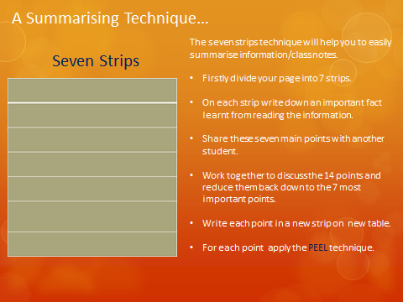

Slide 25
P.E.E.L. Meets ALARM
P = Point… Introduce the topic through the ALARM steps of: Identify, Define, Describe, Explain.
E = Evidence …. Expand upon and support the point using evidence like statistics, specific examples or research findings and quoting an authority or a primary text. Make connections through the ALARM steps of: Analysis
E = Evaluate …. Argue, judge, conclude or justify the merits of the evidence and /or argument provided, looking at the positives and negatives and any contradictions through the ALARM steps of: Critical Analysis.
L = Link … your information to the exam or assessment question AND/OR (in your opinion)its relevance to the real world through the ALARM steps of: Evaluate, Judge, Conclude and Defend

Slide 26
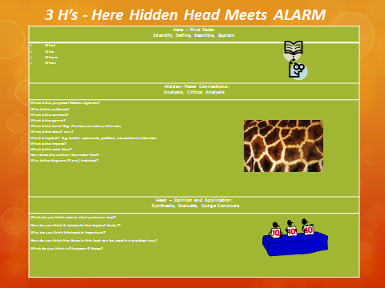

Slide 27
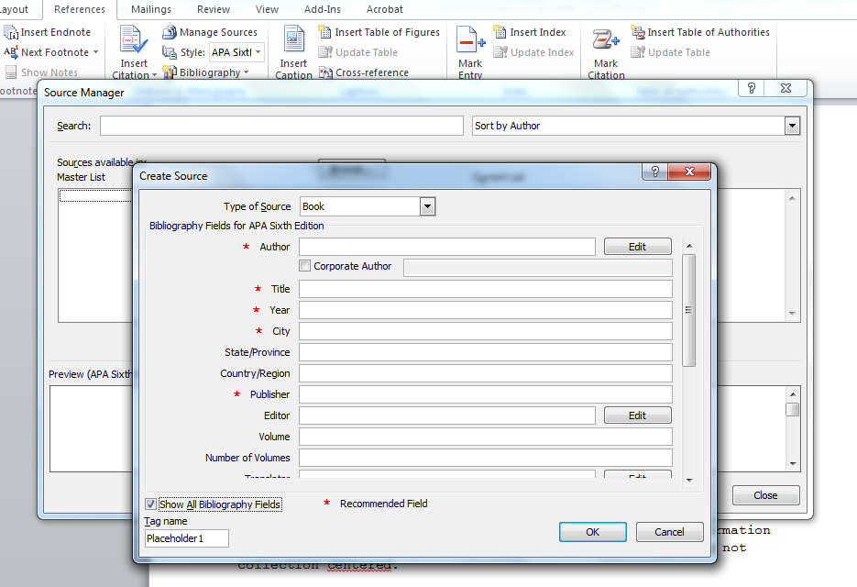
Referencing in Word tutorial

Slide 28
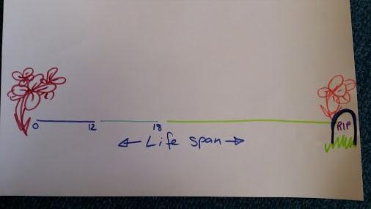
Education is Personal Power

Slide 29
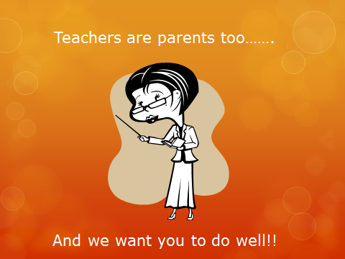

Slide 30
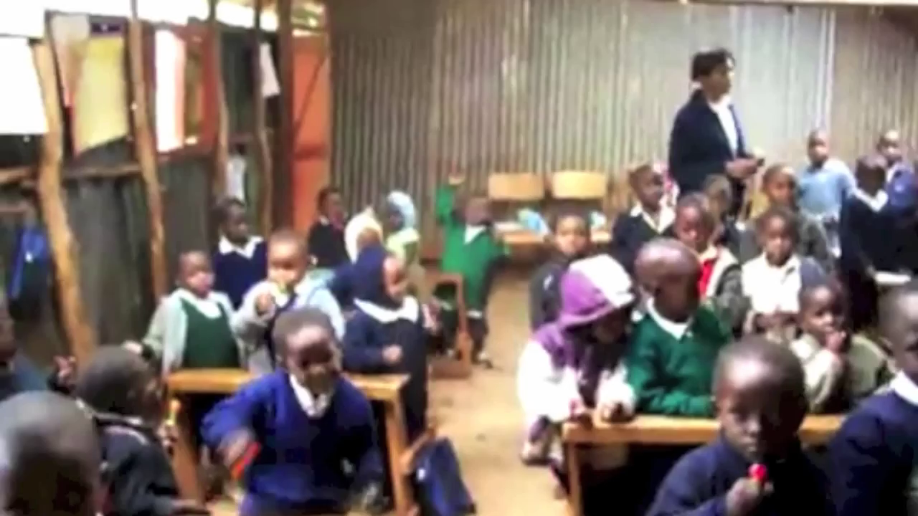

Slide 31
What’s your excuse if you under-achieve?
Education transforms your future
Invest in yourself
Because your parents and teachers are!!!
Power point available via the JHS Li - BLOG - ary

